Slide 1
AASD4011: Mathematical Concepts for Deep Learning
Optimizers

Slide 2
Overview of last session
The cost function is not the same as lost function.
While the loss function computes the distance of a single prediction from its actual value.
The cost function is computing the distance of whole dataset from all the actual values of the samples.
In summarize, the cost function is the sum of loss functions over the training set.

Slide 3



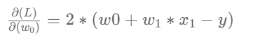

Reminder: The Gradient
The gradient is at the basis of all DL Optimizers
For the MSE loss function:
and a single linear neuron as the model:
The gradient of the loss function with respect to the model parameters is:

Slide 4
Gradient – Detailed Calculation
The functional form of the gradient is constant – it doesn’t change with a change of the input (x,y) or the value of the weights. However the value of the gradient will be different for each combination of inputs and weight values.

Slide 5
Gradient – Detailed Calculation
What will be the value of the gradient for (x=2, y=1, w_0=3, w_1=4)?

Slide 6
Gradient – Detailed Calculation
What will be the value of the gradient for (x=2, y=1, w_0=3, w_1=4)?
(20, 40)

Slide 7
Gradient – Detailed Calculation
What will be the value of the gradient for (x=2, y=1, w_0=3, w_1=4)?
(20, 40)
The gradient represents the direction in which the loss function will increase the most, for a small step taken in (w_0, w_1) around the point (x,y,w_0,w_1).
The negative of the gradient is the direction in (w_0,w_1) in which the function will decrease most in value, for a small step around the point (x,y,w_0,w_1)

Slide 8
Optimizers
Optimizers in machine learning are used to tune the parameters of a neural network in order to minimize the cost of function.
The choice of optimizer is, therefore, an important aspect that can make the difference between a good training and bad training.
There are several optimizers and based on problem that we have we may choose.
Optimizer is one of parameters that we use for hyper parameter tuning.

Slide 9
Categories of Optimizers
Gradient Descent:
Batch Gradient Descent
Stochastic Gradient Descent
Mini Batch Gradient Descent
Adaptive:
Adagrad
Adadelta
RMSprop
Adam

Slide 10

Gradient Descent Optimizer
1- Batch Gradient Descent:
Known as vanilla gradient descent
It is the most basic among the others.
It computes the gradients of the objective function J with respect to the parameters θ for the entire training set.
Formula to update weights in batch gradient descent. The gradients are multiplied by the learning rate η and then used to update the parameters of the network.

Slide 11
Gradient Descent Optimizer
As we use the entire dataset to perform just one step, batch gradient descent can be very slow.
Moreover, it is not suitable for dataset that dont fit in memory.

Slide 12

Gradient Descent Optimizer(SGD)
It is an improved version of batch gradient descent.
Instead of computing the gradients over the entire dataset, it performs a parameters update for each example in the dataset.
Therefore, the formula to updates a weights and values depends on the input x, and output y.
Formula to update weights in SGD

Slide 13
Gradient Descent Optimizer(SGD)
The problem of SGD is that the updates are frequent and with a high variance, so the objective function is very fluctuates during training process.
The advantage of SGD respect to previous is that it allows the function to jump to better local minima, but this feature could be disadvantage as well because it may convergence to the local minima.
The solution is to slowly decrease the learning rate value in order to make the updates smaller and smaller, so avoiding high oscillations.

Slide 14
Stochastic Gradient Descent with Momentum
As we mentioned stochastic Gradient descent takes a much more noisy path than the gradient descent.
It requires more significant number of iterations to reach the optimal minimum, therefore computation time is very slow.
Momentum cause training will be faster convergence of the loss function.

Slide 15
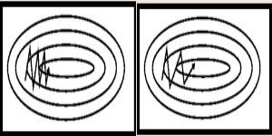
Stochastic Gradient Descent (SGD)
It oscillates between either direction of the gradient and updates the weights.
It adds a fraction of previous update to the current update will make the process faster.
Point: while using this algorithm, the learning rate should be decreased with a high momentum term.

Slide 16

Momentum
DreamStudio: A bowling ball rolling down a hill
Notes:
The image is an analogy for parametric optimization.
So, in the image:
What/Where is the Loss Function? It is the height of the surface
What/Where is the Gradient? It is the slope of the surface
What/Where are the trainable parameters? They are the x and y axes

Slide 17

Momentum
What will happen in real life?
What will happen with gradient descent?
DreamStudio:A bowling ball rolling down a hill with a small stone in front of it

Slide 18
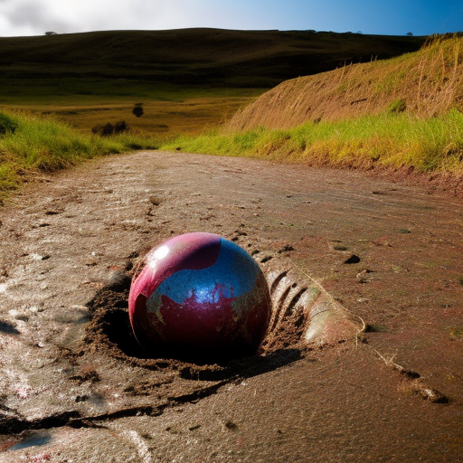
Momentum
Friction and terminal (maximum) speed
DreamStudio: A bowling ball rolling down a muddy hill
Notes:
Terminal / Maximum Speed

Slide 19
Gradient Descent:MiniBatch
This algorithm is the mix of advantage of both gradient descent methods that we mentioned.
It basically computes the gradients on small batches of data in order to reduce the variance of the updates.
Formula to update weights in mini batch gradient descent

Slide 20
Gradient Descent
Mini Batch gradient Descent is the best choice among the three in most of the cases.
Learning rate tuning: all of them are depends on the amount of learning rate.
High possibility to getting stuck into a suboptimal local minima.

Slide 21
Adaptive Optimizers
This family of optimizers has been introduced to solve the issue of gradient descent algorithms.
Their most important feature is that they dont require a tuning of the learning rate value.

Slide 22
Adagrad
It adapts the learning rate to the parameters performing small updates for frequently occurring features and large updates.
In this way, the network is able to capture information belonging to features that are not frequent, putting them in evidence and giving them the right weights.
The problem of adagrad is adjusts the learning rate for each parameter according to all the past gradients.
So, it has the possibility of having a very small learning rate after a high number of steps-resulting from accumulation of all the past gradients.
If the learning rate is too much small, we simply can not update the weights and the consequence is that the network can not learn anything.

Slide 23
Adadelta
It improve the previous algorithm by introducing a history window which sets a fixed number of past gradients to take in consideration during the training.
Therefore, the vanishing gradient will disappear.

Slide 24
RMSprop
It is very similar to adadelta.
The only difference is in the way that manage the past gradients.
This is one of the famous optimiser that you could use.

Slide 25
Adam: Adaptive moment Estimations
It adds to the advantages of adadelta and RMSprop, the storing of an exponentially decaying average of past gradients similar to momentum.
Adam is the best among the adaptive optimizers in most of the cases.
Good with sparse data: The adaptive learning rate is perfect for this type of datasets.
It has adaptive learning rate and there is no need to focus on learning rate.
Reference[1]

Slide 26
Optimizers

